Slide 1
Drugs
IGCSE Biology
Any substance taken into the body that modifies or affects chemical reactions in the body.

Slide 2

Content
Antibiotics
Misuse of heroin
Alcohol
Anabolic steroids
Tobacco smoking

Slide 3

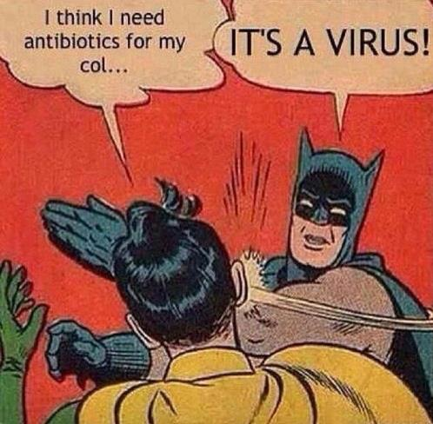
Antibiotics
Antibiotics are substances that kill bacteria, but do not harm other living cells.

Slide 4

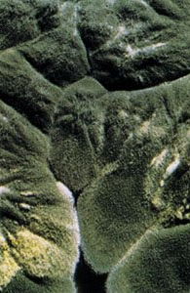
Antibiotics
1. The first antibiotic that has been discovered?
Penicillin, derived from the Penicillium mold. In 1928.
2. What organisms made antibiotics in the nature? Why?
Most of them are made by fungi.
Fungi and bacteria are both decomposers. They compete with each other for food.

Slide 5
Antibiotics
3. Why antibiotics kill bacteria, but do not affect viruses?
Antibiotics kill bacteria in different ways, for example Penicillin stops them from making cell walls.
Antibiotics have no effect on viruses, because viruses do not have cell walls.

Slide 6
Antibiotics
4. What problems may using antibiotics raise? (Why do we or doctors have to be careful as to using antibiotics)/ (Why do scientists go on trying to find more and more antibiotics?)
A: Bacteria evolve to become resistant to antibiotics.
The more we use antibiotics, the more selection pressure we put on bacteria to evolve resistance.

Slide 7
Antibiotics
5. How do we reduce/ minimise development of resistant bacteria?
A: (doctors and patients) Use antibiotics only when essential;
Complete treatment, rather than stop taking drugs when you feel better;

Slide 8


Heroin
1. What is heroin?
Pure heroin (diacetylmorphine) is a white or brown powder with a bitter taste or a sticky black “tar.” abused for its euphoric effects.
Heroin, a highly addictive , depressant drug that slows down the nervous system.
It is usually injected, smoked or snorted up the nose. It exhibits euphoric ("rush"), anti-anxiety and pain-relieving properties.
Notes:
Heroin, a highly addictive drug, is derived from the morphine alkaloid found in opium poppy plant (Papaver somniferum) and is roughly 2 to 3 times more potent than morphine.
Heroin can be a white or brown powder, or a black sticky substance known as black tar heroin. Other common names for heroin include big H, horse, hell dust, and smack.
An opioid, heroin is made from morphine, a narcotic that is commonly used to relieve pain.
After heroin enters the brain, it is converted back into morphine, producing a similar effect to the medicinal drug.
To smoke heroin, users burn the substance and inhale the smoke into the lungs. With snorting, the drug is inhaled in powdered form through the nose. Heroin is also injected intravenously in liquid form.
Following the initial euphoric rush, effects of the drug tend to last a few hours. This period is often referred to as being “on the nod,” a state alternating in and out of drowsiness. A person can be mostly unresponsive to outside stimuli at times during this stage.

Slide 9
Heroin
2. What problems does using heroin cause?
A: addictive;
It causes people to lose self-control and it negatively affects both the physical and mental health of the user;
Lose abilities to work and be part of normal society;
Turn to crime to get money in order to get a dose;
Sharing needles may lead to HIV, hepatitis;
Unpleasant withdrawal problems;
Risk of overdose or death.
Notes:
Heroin has no acceptable medical use in the U.S.

Slide 10

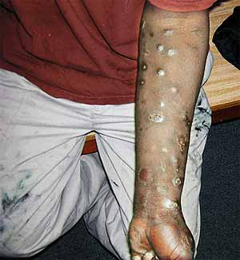

Heroin

Slide 11
Heroin
3. How does heroin affect your nervous system?
A: Heroin is metabolised to morphine, which bind to opioid receptors in the brain, e.g. endorphin receptors. (affect synapses)
Endorphins are a group of neurotransmitters that help to reduce pain, hunger and thirst and affect mood.

Slide 12
Heroin
short-term effects of heroin on body:
﻿depressant;
increases reaction times / slows down impulses / slows down the nervous system; slow breathing can lead to coma;
﻿loss of self-control / mental function is affected / inability to walk or talk;
﻿effect on synapse;
experience a feeling of euphoria, a warming sensation, a heavy feeling in the limbs, and drying of the mouth;
Pupil constriction;
severe itching may occur
https://americanaddictioncenters.org/heroin-treatment/risks-and-effects?__cf_chl_jschl_tk__=pmd_gyynu_LaOevVfYJTJlFi5BTXUHGnjL1NvuKpxc1c3CE-1635686001-0-gqNtZGzNAnujcnBszQe9
Notes:
This surge of euphoric feelings is often accompanied by a warming sensation (warm flushing of the skin), a heavy feeling in the limbs, and drying of the mouth. heroin makes users feel as if things around them have slowed down, and they often feel sleepy/ drowsy as a result, mental function is clouded/ clouded thinking; heart function slows. Pupil constriction, or decrease in the size of the eye pupil, is also common.

Slide 13
Heroin
4. Withdrawal symptoms of heroin.
Agitation/ aggression.
Anxiety/ restlessness/ mood swings/ irritation.
Muscle aches/ cramps/ pain.
Insomnia/ sleeplessness.
Sweating.
Yawning/ Fatigue.
Abdominal cramping.
Diarrhea.
Dilated pupils.
Nausea/ Vomiting.
itching
Hallucinations
Shivering/ chills/ fever
Notes:
﻿itching ;
runny nose / sweating / clammy skin / crying ;
dehydration / (extreme) thirst ;
rapid heart rate / hypotension ; AVP ; cravings / double vision

Slide 14
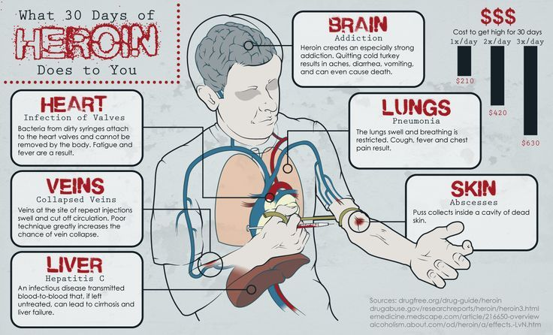
Long-term effects of heroin
Notes:
Continued use of the drug results in a significantly increased tolerance. This means more of the drug needs to be smoked in order to illicit the desired effect. This makes the risk for overdose and serious health complications greater.
Long-term effects: Constipation and stomach issues; Increased risk of developing mental health disorders, such as depression. Insomnia.
Lung issues and increased risk of getting pneumonia because of slowed breathing. This risk is greater if heroin is smoked. Kidney or liver damage or disease.
Altered or irregular menstrual cycles in women. Sexual dysfunction in males.

Slide 15
Depressant
Depressant: a drug that inhibit the function of the central nervous system (CNS) hence slows the activity of vital organs of the body.
Depressants will put you to sleep, relieve anxiety and muscle spasms, and prevent seizures.
The following effects may be experienced: slowed reaction time, impaired judgement, slowed breathing and heart rate, reduced inhibitions, enhanced mood.
E.g. alcohol, opioids (codeine, morphine, heroin)
Stimulant: increase mental and/or physical function (CNS and the body functions),
E.g. nicotine, caffeine, cocaine
Stimulant

Slide 16


Alcohol
Alcohol is a depressant – it slows down nerve impulses, meaning reaction times are longer.
Too much can affect people’s judgement, which can result in accidents.
Increase aggression.
(blush, feel warm and toasty, become more reckless and uninhibited, talkative, less coordinated, slurred speech, Impaired concentration/attention, blurred vision, coma, loss of consciousness, nausea, vomiting, dehydration, headache, numbness …
In what cases do you think alcohol can help you?
Notes:
90% of alcohol is metabolized in the liver by oxidation via action of the enzyme called “alcohol dehydrogenase (ADH)”, while less than 10% is eliminated in breath, sweat, and urine. People with alcohol-related cirrhosis are at much higher risk for development of liver cancer.

Slide 17
Alcohol
Short-term and long-term effects on body
https://www.nhs.uk/conditions/alcohol-misuse/risks/
https://www.healthline.com/health/alcohol/effects-on-body
https://www.alcohol.org.nz/alcohol-its-effects/health-effects/alcohol-related-health-conditions
https://www.alcohol.org.nz/alcohol-its-effects/health-effects/alcohol-poisoning

Slide 18
Alcohol
Drinking too much will cause liver damage, including cirrhosis (the body starts to replace the liver’s healthy tissue with scar tissue), alcoholic hepatitis, fatty liver, even liver cancer.
It can also lead to reduced brain function, e.g. memory loss and confusion.
Long term alcohol use can cause high blood pressure, or hypertension.
Alcoholism: Over time, people can become addicted to alcohol.

Slide 19
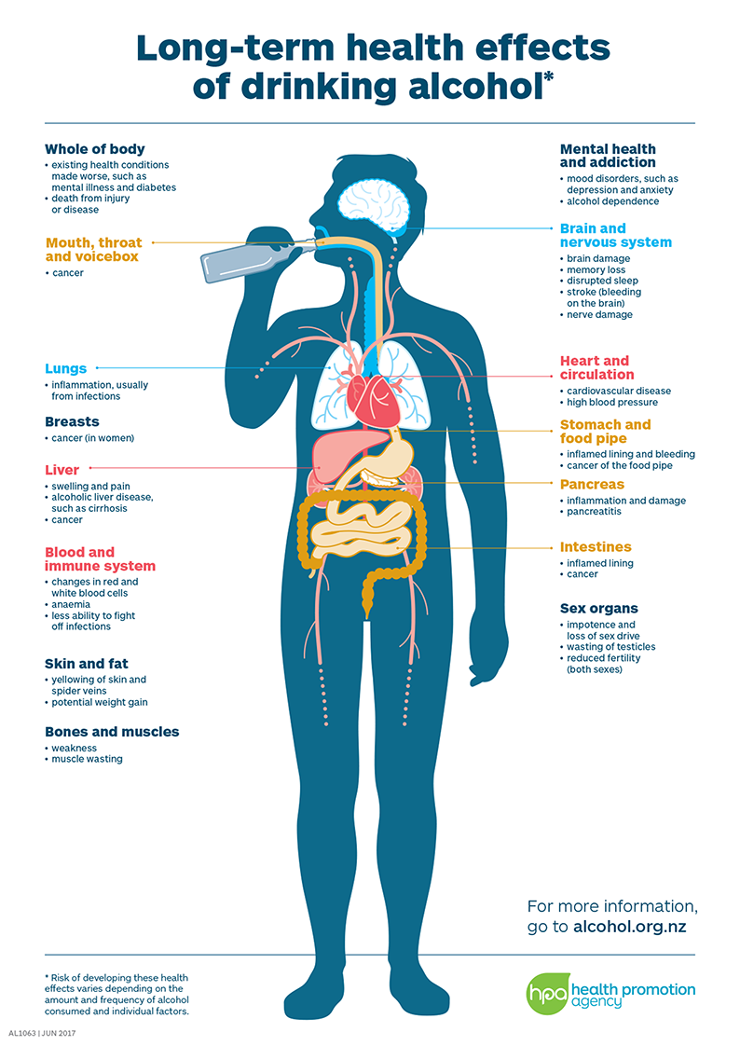
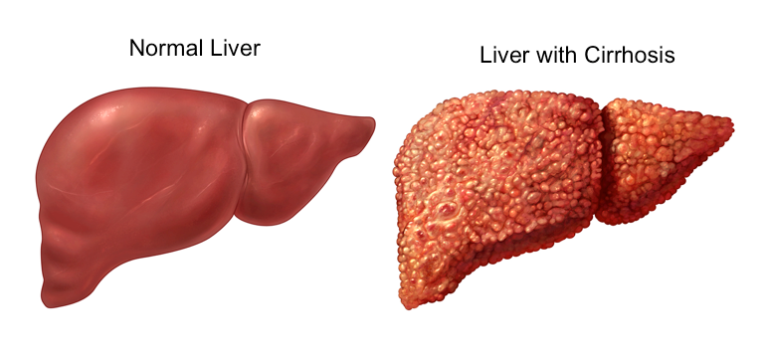
Why is liver severely damaged by heavy drinking?

Slide 20
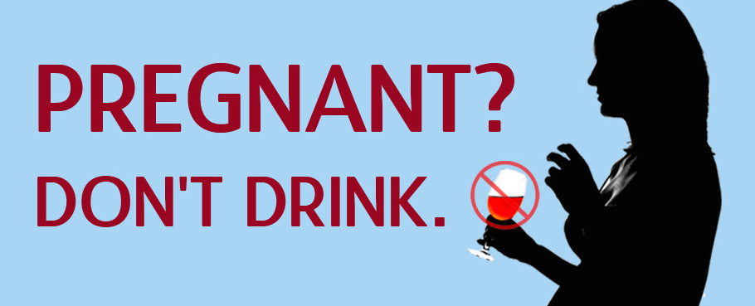
Alcohol
Sometimes pregnant women drink alcohol and this can be very dangerous for the development of the unborn baby.
Babies may be born earlier than normal (premature), they may be underweight and have problems with development.
Notes:
Alcohol can cause different parts of the fetus to develop abnormally. It can also disrupt the way nerve cells develop, function, and travel to form different parts of the brain. By constricting the blood vessels, alcohol interferes with blood flow in the placenta, which hinders the delivery of nutrients and oxygen to the fetus.

Slide 21
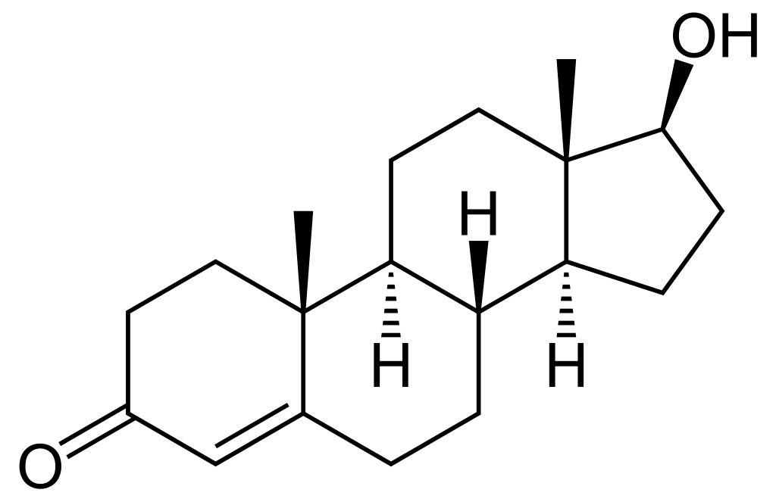
Abuse of anabolic steroids
Anabolism: the synthesis in living organisms of more complex substances from simpler ones (opposed to catabolism)
Steroids: a group of fat-soluble organic compounds featured with four rings.
The main anabolic steroid hormone produced by your body is testosterone.
Anabolic steroids are prescription-only medicines. Some athletes take anabolic steroids to increase their muscle mass and strength and improve athletic performance.
Have physical health risks.
Is prohibited and illegal.
Testosterone, one natural type of anabolic steroids
Notes:
There are many so-called performance-enhancing drugs such as anabolic steroids, androstenedione, human growth hormone, erythropoietin, diuretics, creatine and stimulants.

Slide 22
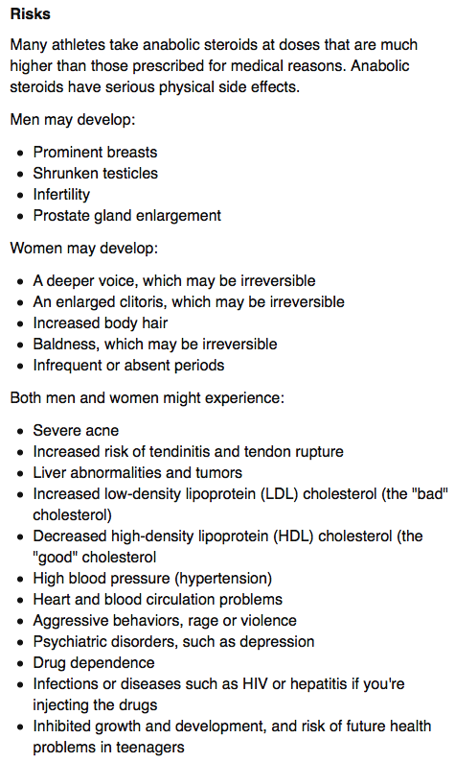
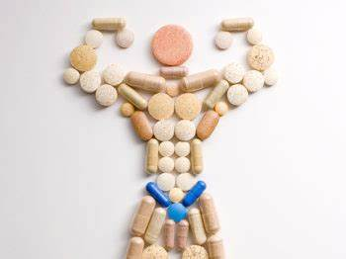

Abuse of anabolic steroids
https://www.mayoclinic.org/healthy-lifestyle/fitness/in-depth/performance-enhancing-drugs/art-20046134

Slide 23
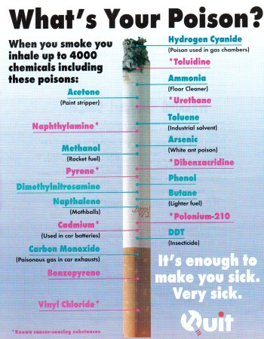
Smoking
Leads to a variety of cancers, circulatory problems and respiratory infections among others.
Main harmful components:
1. nicotine
2. tar
3. CO
Notes:
According to the National Cancer Institute (NCI), tobacco smoke contains over 7,000 chemicals. The majority are found in the tar produced by smoking cigarettes.

Slide 24
Nicotine
Nicotine is a naturally occurring alkaloid found in tobacco plants.
Nicotine binds to receptors in the brain and muscles.
Nicotine travels through the bloodstream and reaches the brain within 10 to 19 seconds.
https://healthfully.com/effects-of-nicotine-on-the-muscles-4617277.html
https://www.medicalnewstoday.com/articles/240820#effects
Notes:
Nicotine causes the release of adrenalin and noradrenalin, which are hormones produced by the adrenal glands. In the cardiovascular system, nicotine acts as a stimulant.
Nicotine also makes the pancreas produce less insulin, causing a slight increase in blood sugar or glucose.
Nicotine causes an increased metabolism. Smokers typically weigh 6 to 9 pounds less than nonsmokers. This effect has been correlated with the finding that smokers who quit smoking tend to gain 6 to 9 pounds.
Nicotine has a depressant effect on appetite. Anorexia, or loss of appetite, is common among smokers and is part of the reason for the typical lower weight found among smokers.
Indirectly, nicotine causes the release of dopamine in the pleasure and motivation areas of the brain. A similar effect occurs when people take heroin or cocaine. The drug user experiences a pleasurable sensation.
Nicotine (6.1 microM) stimulated secretion of beta-endorphin in mouse.

Slide 25
Nicotine
This is an addictive drug that affects the brain. It makes people feel more relaxed. It also results in the relaxation of smooth muscle.
Nicotine affects the cardiovascular system, acting as a stimulant. It increases heart rate, causes the blood vessels to constrict, increases blood pressure so can lead to heart disease.
Nicotine also increases the risk of blood clotting.
Smoking a cigarette will elevate your heart rate and stimulate release of adrenaline, making you feel more alert.
Q: Do you think nicotine can help athletes to improve their performance shortly?

Slide 26
Nicotine
Why do nicotine enhance pleasure?
Nicotine also can have effects on the parts of the brain that sense pleasure.
When nicotine gets into the brain, it is able to stimulate the release of a neurotransmitter called dopamine.
Dopamine activates some of the neurons in the part of the brain that register pleasure.
As a result, nicotine triggers a chemical sensation of pleasure.

Slide 27

Effects of smoking on health - tar
Cigarette tar is a term used to describe the toxic chemical particles left behind by burning tobacco. This substance forms a tacky brown or yellow residue.
Tar contains many different chemicals called carcinogens that can cause cancer, mainly lung cancer.
The chemicals damage the DNA in cells particularly in the lungs or tubes leading to the lungs.
The tar in cigarette smoke builds up inside the lungs as it is inhaled. Over time, a healthy pink lung tissue turns grey and eventually becomes black as more tar accumulates.
Notes:
The concentration of tar in a cigarette determines its rating. High-tar cigarettes (regular or full-flavor) contained 15 milligrams (mg) or more of tar. Medium-tar (light) cigarettes had 6mg to 15mg, and low-tar (extra-light or ultra-light) cigarettes contained 1mg to 6mg of tar.

Slide 28
Effects of smoking on health - tar
Tar also affects the linings of the tubes leading towards the lungs:
It destroys or paralyses the cilia, so that they can no longer move mucus up to the throat.
The tar stimulates the goblet cells to make more mucus than usual. The mucus slides into the lungs where bacteria can breed and cause disease.
The person tries to remove the mucus by coughing - which can damage the lungs and the lining of the tubes even more. This is called bronchitis.

Slide 29
Effects of smoking on health - tar
Sometimes the damage is so bad that the walls of the alveoli break down, leading to large open air spaces instead of many small ones. This decreases the total area for gas exchange across alveoli.
This stops oxygen and carbon dioxide moving easily in and out of the blood.
The person finds it difficult to get enough oxygen. This is called emphysema.
Some symptoms include: shortness of breath, long duration cough which can be dry or with mucus, fatigue, etc.
Notes:
You can have emphysema for many years without noticing any signs or symptoms. The main symptom of emphysema is shortness of breath, which usually begins gradually.
You may start avoiding activities that cause you to be short of breath, so the symptom doesn't become a problem until it starts interfering with daily tasks. Emphysema eventually causes shortness of breath even while you're at rest.

Slide 30
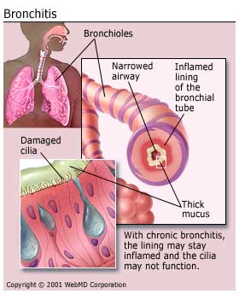
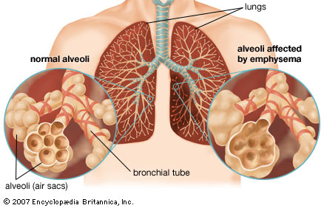
COPD
Chronic obstructive pulmonary disease (COPD) is estimated to affect 32 million persons in the United States and is the third leading cause of death in this country.
Patients typically have symptoms of chronic bronchitis and emphysema, but it also includes asthma or a combination of the above
Notes:
Smoking is the leading cause of COPD. Treatment may slow the progression of COPD, but it can't reverse the damage.

Slide 31
Effects of smoking on health - Carbon monoxide
This diffuses into the blood from the alveoli.
Carbon monoxide combines irreversibly with haemoglobin, i.e. it will not separate from it.
The haemoglobin cannot be used for carrying oxygen, so smokers are likely to run short of oxygen if they try to do anything very energetic.

Slide 32
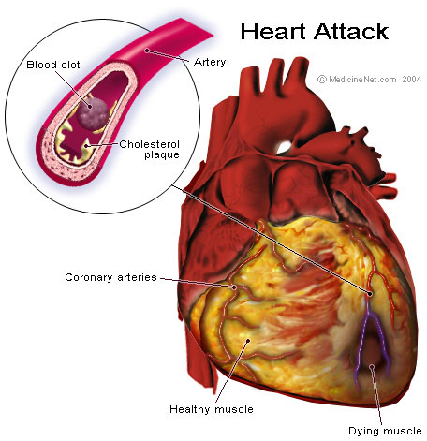
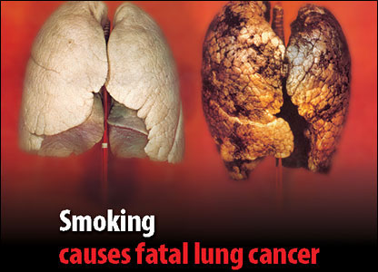
Effects of smoking on health

Slide 33
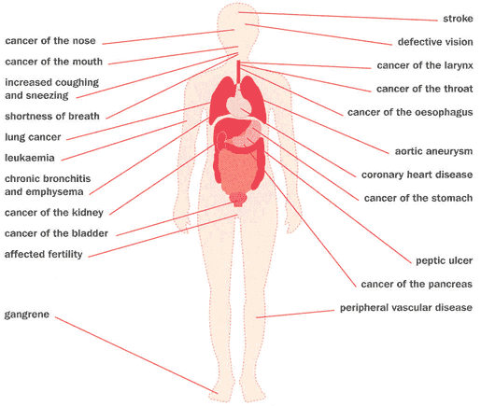
Effects of smoking

Slide 34
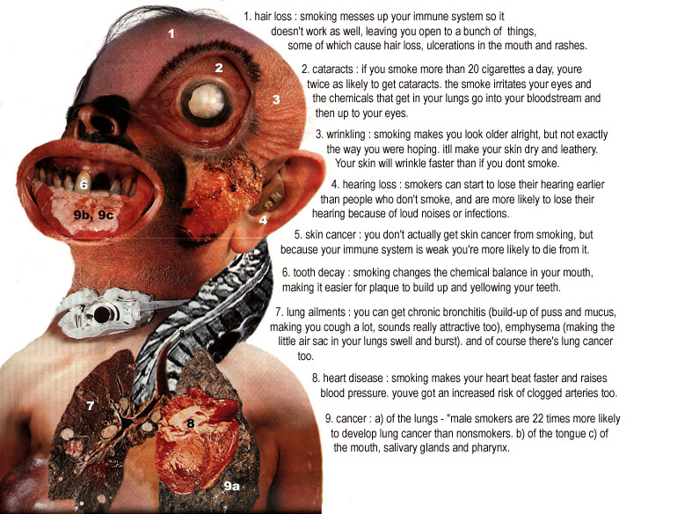
Are you ready?

